Slide 1
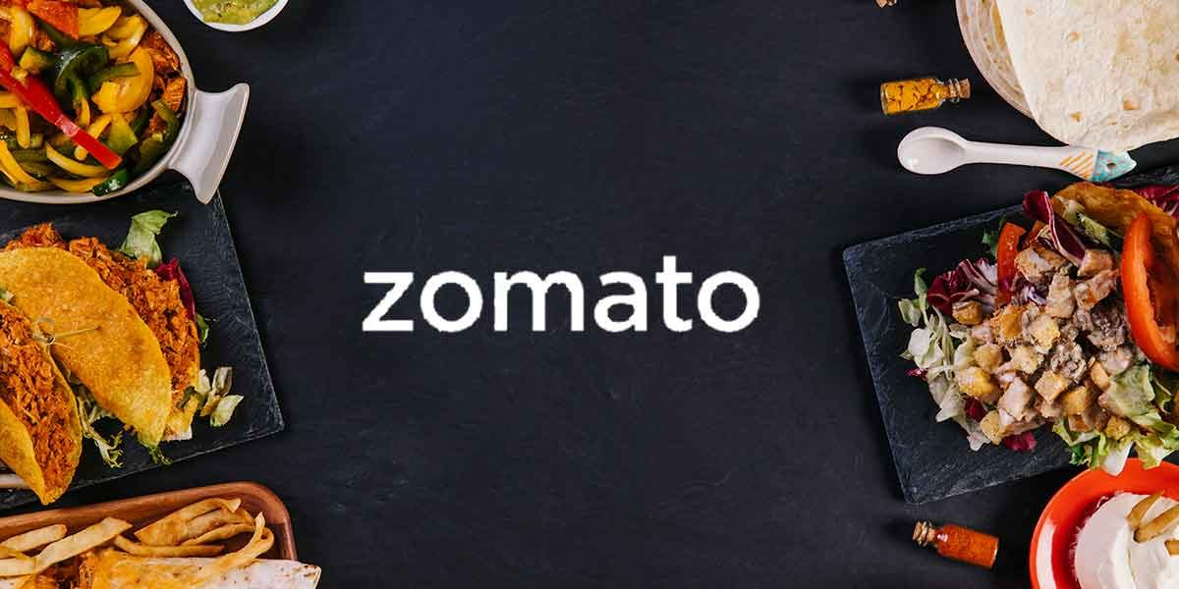
Business
Information

Slide 2
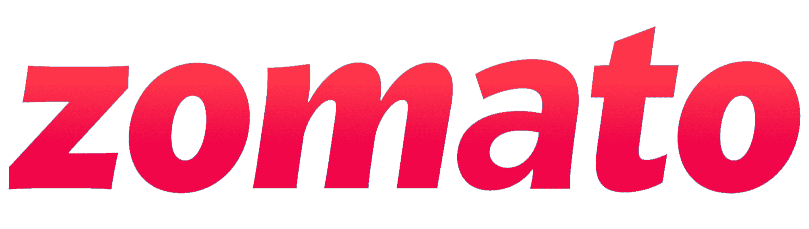
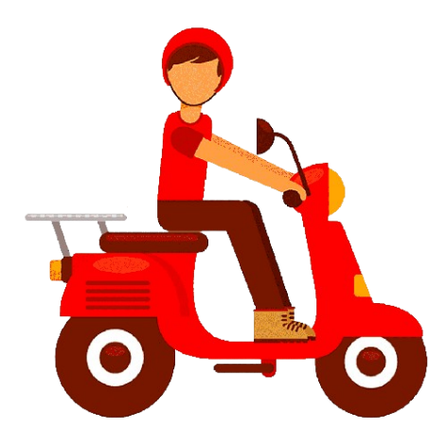
Business Overview
9,551
Total Restaurant
15
Country
141
Cities
1

Slide 3
Online Delivery
Zomato is a online food delivery brand in that situation only 26 precent restaurant attached with Zomato have online delivery facilities. Zomato should increase that number and more collapse with restaurants having online delivery.
2

Slide 4
Online Delivery
Zomato is also focusing on its new initiative "Zomato Dine In" in that situation only 12 precent restaurant attached with Zomato have Table booking facilities. Zomato should increase that number and more collapse with restaurants having Booking facilities.
3

Slide 5
Online Delivery
In Zomato 46% Restaurants has Good rating which means less then 50% are serving quality food to the consumers.
43% Restaurants (combining 22% Poor and 41% Average) are serving a low quality food which leads to unsatisfactory costumers.
Zomato should change their guidelines and take some actions of low rating restaurants, that will gain costumers trust.
Rating Points | Rating | Restaurants
1 to 2 | Poor | 2158
2 to 3 | Average | 1891
3 to 4 | Good | 4381
4 to 4.5 | Best | 907
4.5 to 5 | Excellent | 205
4

Slide 6
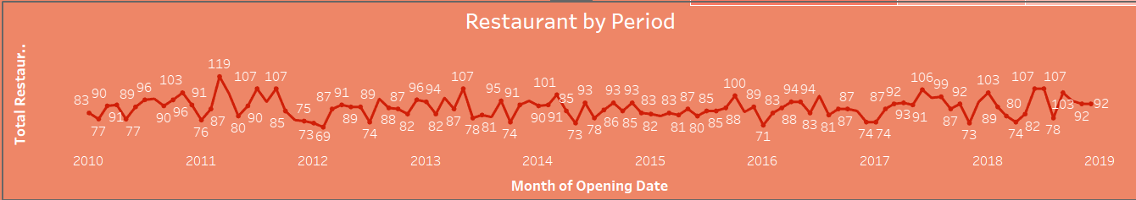
Online Delivery
In terms of collaborating with new restaurants Zomato is constant over the period.
5

Slide 7
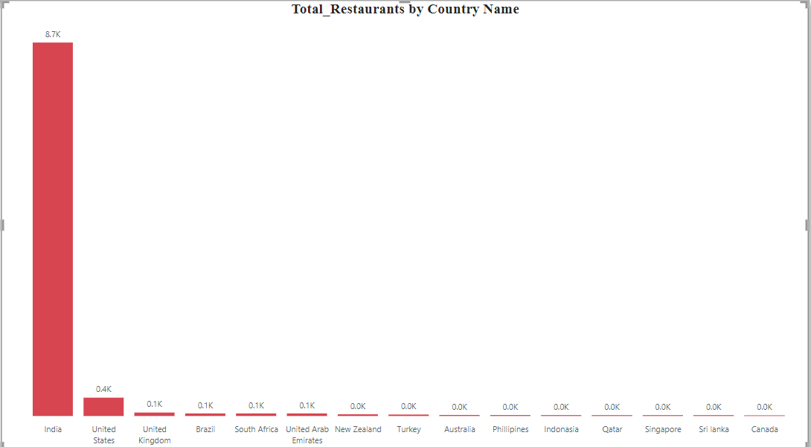
Online Delivery
Zomato has maximum number of restaurants in India.
The First reason may be bcoz of it’s a Indian Start-up.
But according to the report Zomato is focusing in U.S., U.K. and Brazil only after Inidia.
Zomato should focus on other countries of Asia region.
6

Slide 8
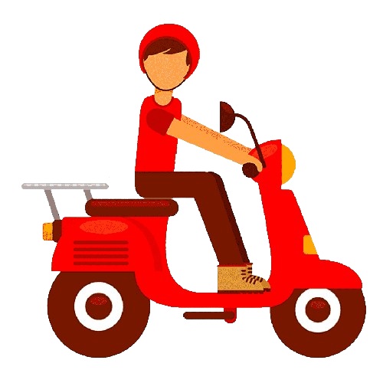
Thank You
Presented By: Group 2

